Slide 1

Advanced Movie Recommendation System using SVD
Building intelligent recommendations through collaborative filtering and matrix factorization
By: Vignesh R, Joel James, Aadhikasavan
Notes:
Add name : Vignesh R

Slide 2

The Challenge
The Problem
With thousands of movies available, users struggle to discover content that matches their unique preferences. Traditional browsing falls short in personalization.
Our Goal
Build a sophisticated recommendation engine that leverages user behavior patterns and preferences to deliver personalized movie suggestions.

Slide 3



Technical Approach
Singular Value Decomposition
Rating Filters
Genre Classification
Quality thresholds ensure recommended movies meet minimum rating standards
Category-based filtering allows users to narrow recommendations by preference
Matrix factorization technique to uncover latent features in user-movie interactions
Our hybrid approach combines collaborative filtering with content-based methods for optimal results.

Slide 4
Dataset Overview
MovieLens Dataset
6K+
4K+
Ratings Data
user_id, movie_id, rating, timestamp
Unique Users
Movies
Source: ratings.dat
Active raters in dataset
Across all genres
Movies Data
movie_id, title, genre
1M+
Source: movies.dat
Total Ratings
User interactions

Slide 5
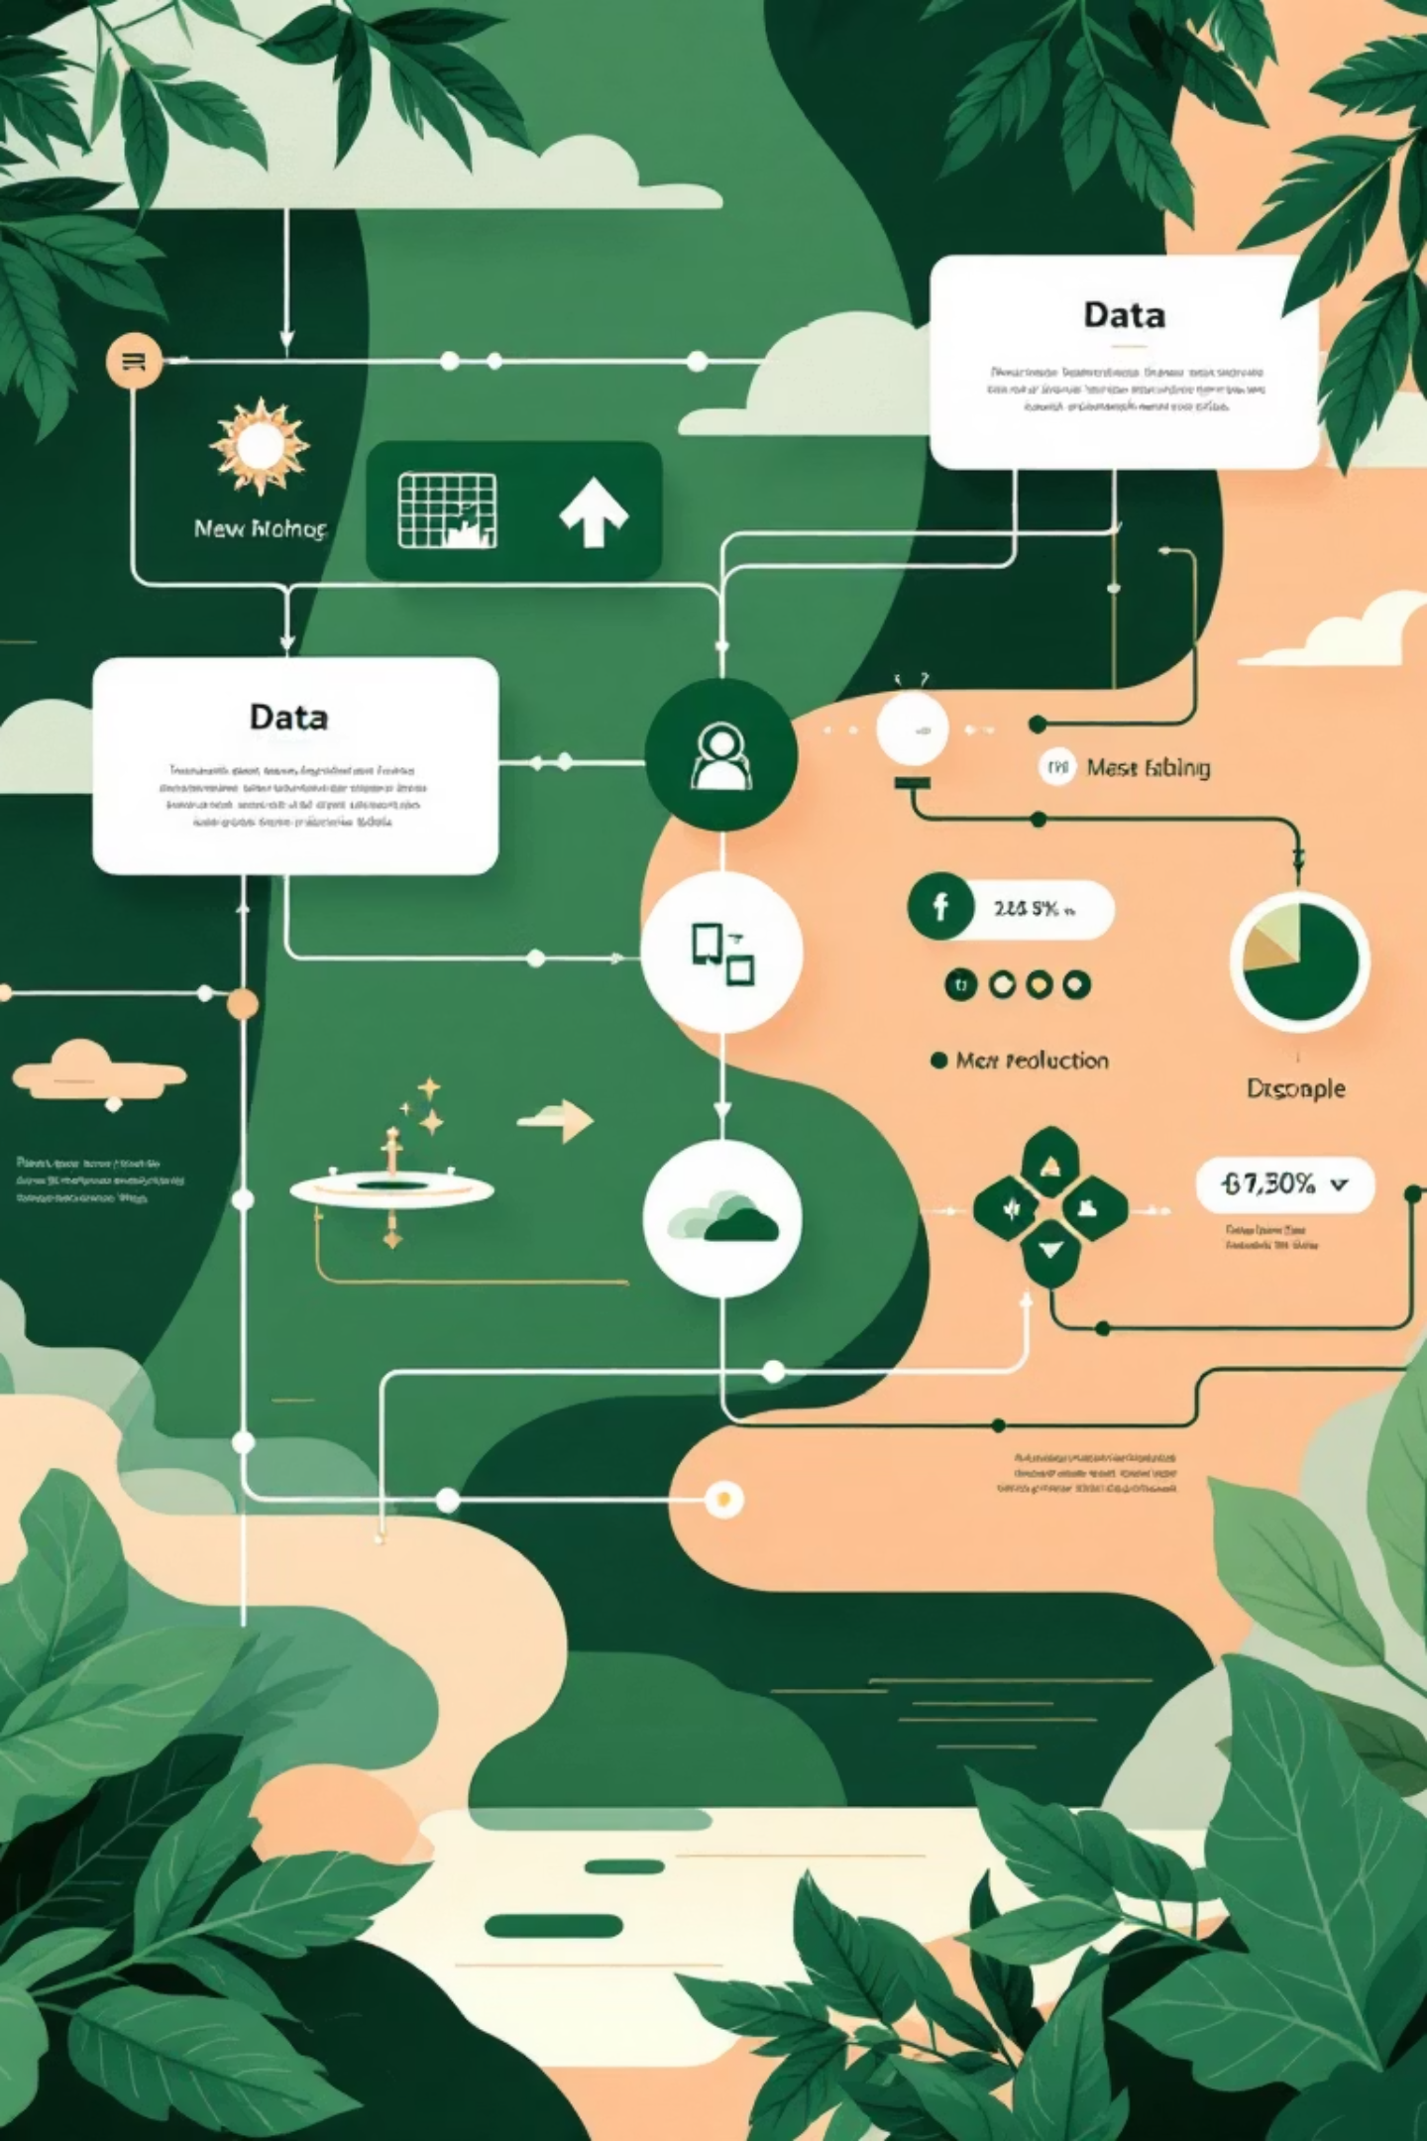



Data Preprocessing Pipeline
Load Data
Import ratings and movies datasets using Pandas
Merge & Clean
Combine datasets and handle missing values
Create Matrix
Build user-movie interaction matrix with pivot_table

Slide 6
Three Recommendation Strategies
1
2
3
Genre-Based Filtering
Rating-Based Selection
Collaborative Filtering (SVD)
Filter movies by user-specified genre, then rank by average rating to surface top-rated content within preferred categories.
Recommend globally popular movies with highest average ratings across entire dataset—ideal for new users without history.
Apply matrix factorization to discover latent patterns, calculate user similarity via cosine distance, and recommend based on similar users' preferences.

Slide 7

Streamlit User Interface
Main Display
User ID: Select target user
Interactive results table with movie details, ratings, and genres. Users can dynamically switch between recommendation methods and see real-time updates.
Genre: Filter by movie category
Min Rating: Quality threshold
Sample dataset preview enables exploration of underlying data.
Count: Number of recommendations

Slide 8

Example Output
User ID: 1 | Genre: Action | Top 5 Recommendations
Movie ID
Title
Genre
Avg Rating
2571
The Matrix
Action|Sci-Fi
4.5⭐
1196
Star Wars: Empire Strikes Back
Action|Adventure
4.3⭐
260
Raiders of the Lost Ark
Action|Adventure
4.2⭐
1210
Terminator 2: Judgment Day
Action|Sci-Fi
4.1⭐
1270
Die Hard
Action|Thriller
4.0⭐
Recommendations are personalized based on user's viewing history and preferences of similar users.

Slide 9

Key Takeaways
Hybrid Architecture
Scalable Design
Combines genre filtering, rating thresholds, and collaborative filtering for robust recommendations
SVD efficiently handles large sparse matrices with millions of ratings
User-Centric Interface
Streamlit provides intuitive controls and real-time interaction for optimal user experience

